Slide 1

Introduction to SU² Code Structure
SU² Release Version 2.0 Workshop
Stanford University
Tuesday, January 15th, 2013
Amrita K. Lonkar
Department of Aeronautics & Astronautics
Stanford University
Notes:
Hi I am Amrita Lonkar and in this talk, I will briefly explain the code structure of SU2.

Slide 2
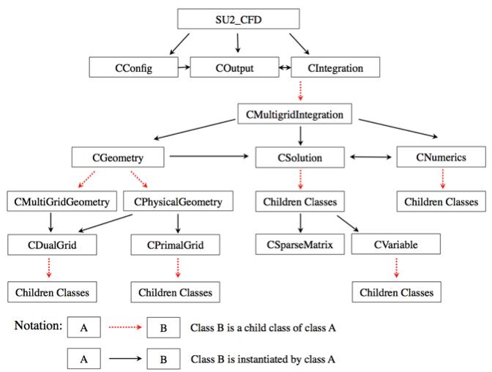
SU²- Object Oriented Structure
Why Object Oriented?
Easy to add new capabilities
Easy to leverage a lot of existing capabilities.
Notes:
SU2 is open-source and we all can use it and we can go inside the code and change things to customize it for our needs. Researchers can add new capabilities which aren’t fully supported at the moment, one can include a completely new set of equations, new boundary conditions, new turbulence models.
And this can be done very easily owing to the object oriented structure of SU2. OO Programming consists of interacting objects as opposed to a program that has a list of tasks it performs, there are bins for every capability, for example, a different class for every set of governing equations, there is a bin for Euler equations, one for plasma equations, and if you want to solve a completely new set of equations, you can just one more bin to this structure and connect it to the rest of the program without actually having to modify the rest of the code.
This is why it’s important to understand the class structure of the code.

Slide 3
SU² Modules
SU2_CFD – The main PDE solution module
SU2_DDC – The Domain Decomposition Code
SU2_MAC – The Mesh Adaptation Code
SU2_MDC- The Mesh Deformation Code
SU2_PBC – The Periodic Boundary Condition Code
SU2_SMC – The Sliding Mesh Code
Notes:
This is a high level view of the code, once you get a copy of SU2 on your local computer and you look into the trunk directory, you will see these directories (in addition to a few others). These directories have the source code and I will quickly glance over what each one of these does.
SU2_CFD is the main module that solves the partial differential equations.
SU2_DDC is used when you want to run a solution on multiple processors, it breaks the mesh for each processor.
SU2_MAC is the mesh adaptation code, used to dynamically refine meshes for better accuracy while a flow solution is in progress.
SU2_MDC is the mesh deformation code used to deform meshes while a flow solution is in progress.
SU2_PBC is a preprocessor used when you have periodic boundary conditions, it creates halo cells around periodic boundaries.
Then, you have SU2_SMC which is called when you have sliding meshes.
In this talk, we are going to focus on the main module, which is SU2_CFD.

Slide 4
SU2_CFD Module
1a) Read Input
Class: CConfig
Read the config file
1b) Read Mesh
Class: CGeometry
Read the mesh file
Set up multigrid meshes
trunk/Common/
2) Solve Equations
Pick Solver
Class: CSolution
Euler Equations: CEulerSolution
Plasma Equations: CPlasmaSolution
Adjoint Equations: CEulerAdjSolution
And others…
3) Write Output
Class: COutput
Print on screen
Write solution file
Write restart file
Write history file
trunk/Common/
Store Flow Variables
Class: CVariable
Stores variables at every mesh node.
Declare & store all flow variables
CEulerVariable: Density, energy etc.
CNSVariable: + Viscosity
CAdjVariable: Adjoint variables
And others…
Discretization
Class: CNumerics
Spatial Discretization
Convective Flux, Jacobian
CNumerics:: Roe/JST/etc.
Viscous Flux, Jacobian
CNumerics:: Avg_Grad/etc.
Source Terms, Jacobian
CNumerics:: PieceWiseConst.
Temporal Discretization
Explicit Euler/ Runge-Kutta
Implicit Time Integration
Solve Linear System
Class: CSparseMatrix
BiCSTAB
GMRES
LU-SGS
Preconditioners
Linelet
Jacobi
Update solution vector
Notes:
SU2_CFD does three things, mainly, it reads the input configuration file and the mesh file. It solves the governing equations and then it outputs the solution in a file.
Now let’s look at each of these in a little bit detail, before I begin, let me mention that SU2 names every class starting with a C followed by what it does.
So, Cconfig is a class for reading and storing the configuration specs, Cgeometry is to read and store the geometry. we will start with the input. If one is using multigrid to accelerate convergence by using multiple meshes with different degree of coarseness, then Cgeometry creates different meshes inside the code, which are used by the solver. You can output these meshes too if you want to look at them.
Then, let’s go to the Output class, Coutput, which is used to print the residuals on the screen, write the converged solution to files in tecplot/paraview format and other things.
These two classes are defined in the Common directory, because they are used by the other modules too.
Next, l

Slide 5
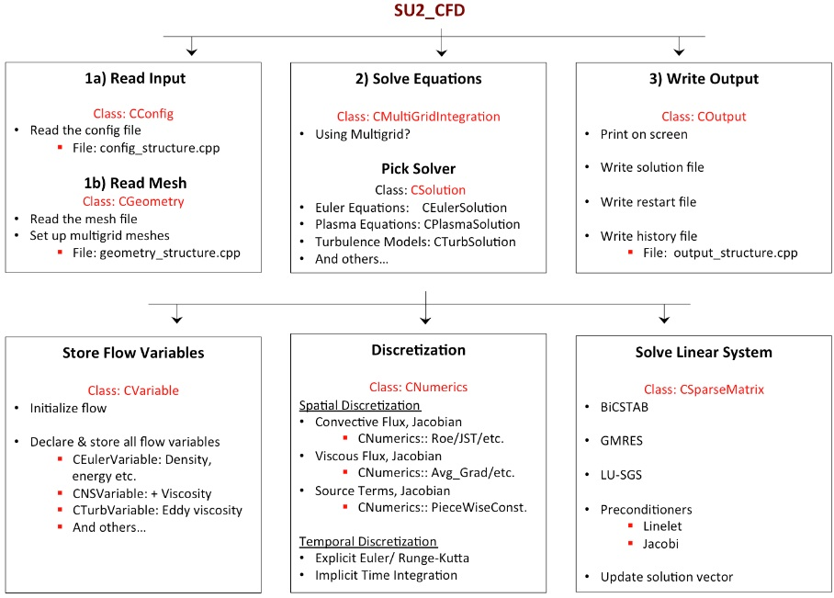
CGeometry Class
CGeometry
CPhysicalGeometry
CMultiGridGeometry
CPrimalGrid
CDualGrid
Children Classes
Children Classes
Parent Class: CDualGrid
Parent Class: CPrimalGrid
Files in Common/include:
geometry_structure.hpp
geometry_structure.inl
In Common/src
geometry_structure.cpp
CEdge
CHexahedron
CPoint
CLine
CVertex
CPyramid
CRectangle
CTetrahedron

Slide 6
CSolution Class
Parent Class: CSolution
CSolution
CEulerSolution
CNSSolution
CTurbSolution
CTurbSASolution
CSolution
CEulerSolution
CPlasmaSolution
CTurbSSTSolution
CWaveSolution
New Turbulence Model
CVariable
CNumerics
CSparseMatrix
CVariable
CNumerics
CSparseMatrix
CFEASolution
CHeatSolution
CEulerVariable
CRoe_Flow
CLevelSetSolution
CAdjEulerSolution
CAdjNSSolution
Files in SU2_CFD/include:
solution_structure.hpp
solution_structure.inl
In SU2_CFD/src
solution_direct_mean.cpp
solution_adjoint_mean.cpp
solution_direct_plasma.cpp
solution_direct_template.cpp
etc.
CAdjTurbSolution
CAdjPlasmaSolution
CAdjLevelSetSolution
CLinEulerSolution
CTemplateSolution

Slide 7
CVariable Class
Parent Class: CVariable
CEulerVariable
CNSVariable
Stores variables for a particular solution class, at EVERY grid node.
CTurbVariable
CTurbSAVariable
CSolution
CPlasmaVariable
CTurbSSTVariable
CWaveVariable
New Turbulence Model
CVariable
CNumerics
CSparseMatrix
CFEAVariable
CHeatVariable
CLevelSetVariable
CAdjEulerVariable
CAdjNSVariable
Files in SU2_CFD/include
variable_structure.hpp
variable_structure.inl
SU2_CFD/src
variable_direct.cpp
variable_adjoint.cpp
variable_template.cpp
etc.
CAdjTurbVariable
CAdjPlasmaVariable
CAdjLevelSetVariable
CLinEulerVariable
CTemplateVariable

Slide 8
CNumerics Class
Parent Class: CNumerics
Roe’s Scheme
Average Gradient
Piecewise Constant Source
Child Classes for:
Convective Flux Discretization + Jacobian
Viscous Flux Discretization + Jacobian
Source Terms Discretization + Jacobian
JST Scheme
Galerkin
CSolution
Plasma Source
AUSM Scheme
Average Gradient Corrected
Gravity Source
HLLC Scheme
Template Viscous Terms
CVariable
CNumerics
CSparseMatrix
Electrical Source
Steger-Warming Scheme
Turbulence Source
Roe-Turkel for low Mach
Transition Source
Lax-Friedrich Scheme
Files in SU2_CFD/include
numerics_structure.hpp
numerics_structure.inl
In SU2_CFD/src:
numerics_structure.cpp
numerics_convective.cpp
numerics_viscous.cpp
numerics_source.cpp
Upwinding for Turb Scalar
Axisymmetric Source
Template Convective Terms
Rotational Frame Source
Free Surface Source
Template Source Terms

Slide 9
More here…
SU² Paper:
Stanford University Unstructured (SU2): An open-source integrated computational environment for multiphysics simulation and design. AIAA 2013-0287
Developers contact:
susquared-dev@mailman.stanford.edu
Thank you

